Slide 1
3D Visualization in GIS

Slide 2
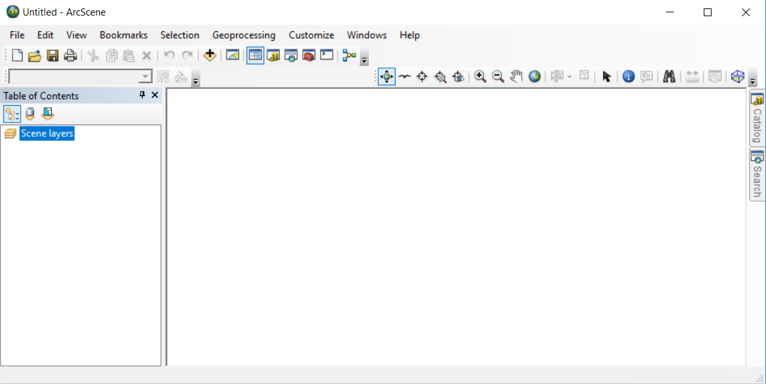
ArcScene
-- stand-alone software program compatible with ArcMap
ArcGIS Pro, ESRI CityEngine
-- incorporate 3D display capabilities
QGIS
-- NVIZ, Qgis2threejs plugin
or export to 3D modeling software like Blender

Slide 3
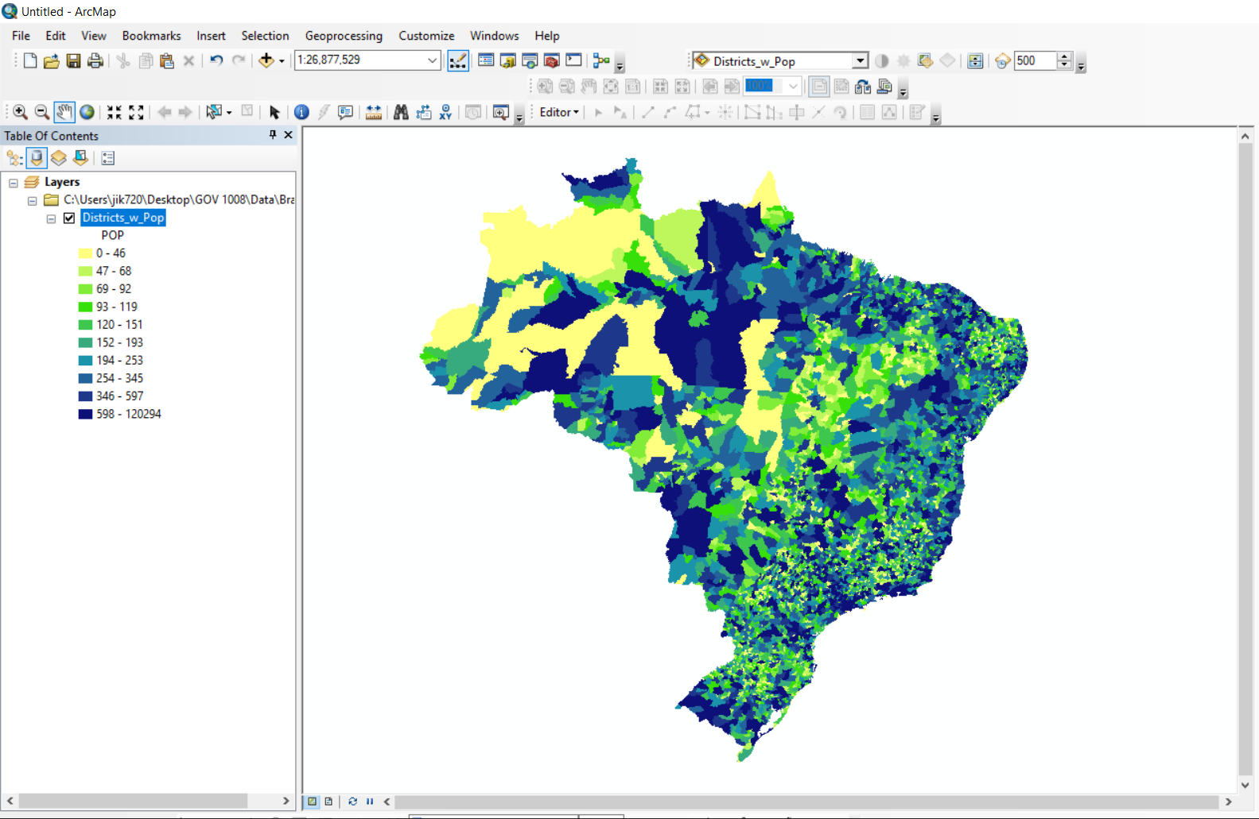
Displaying
shapefiles
in 3D:
Start in ArcMap.
Set the symbology.
Decide which field will provide the height values.
In this example, the map of Brazil is colored by district population.
But we’ll display population density in 3D.
Copy the layer.

Slide 4
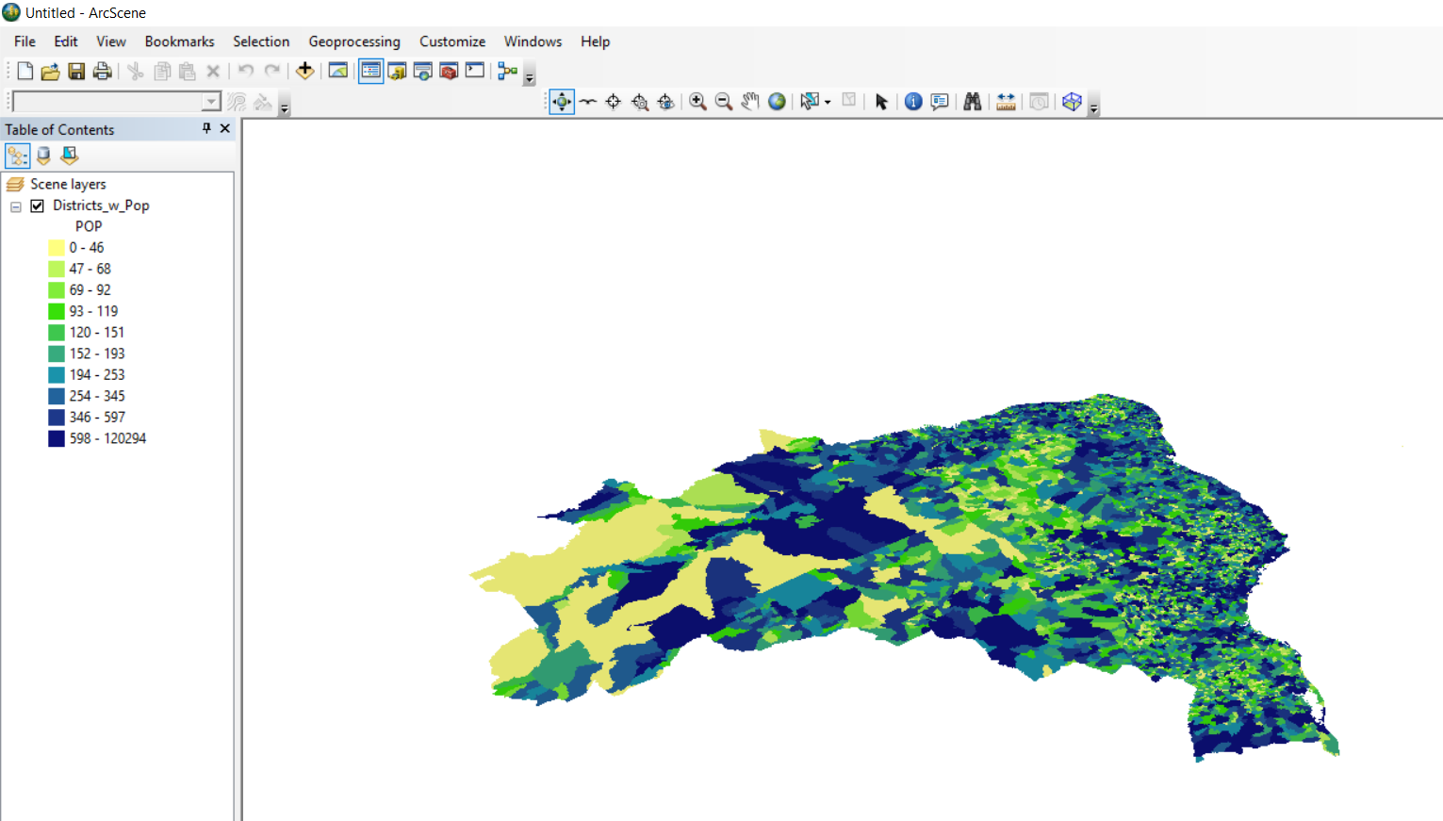
Then paste it into ArcScene.
It shows up flat, but in perspective.
Use the Navigate cursor to tip and rotate the image.
Other icons work similarly to the way they do in ArcMap.
The Fly cursor is a lot of fun, but since there is no back button, it’s easy to get lost.

Slide 5
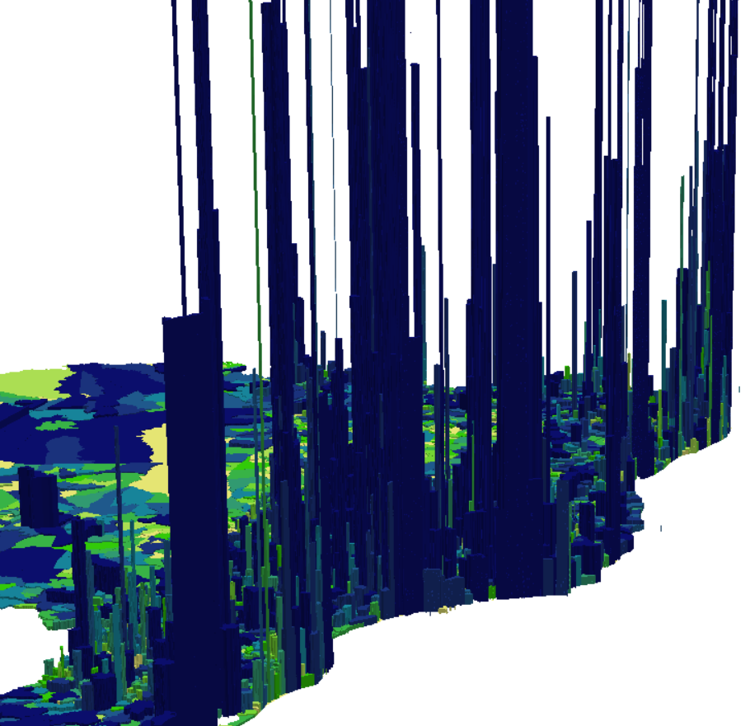
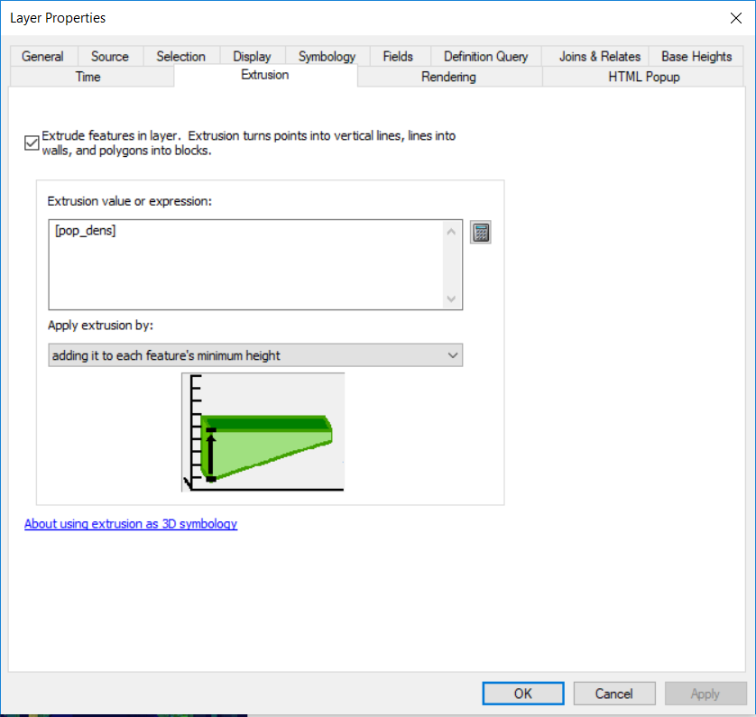
Right-click > Properties > Extrusion
The calculator allows you to pick which field to extrude.

Slide 6
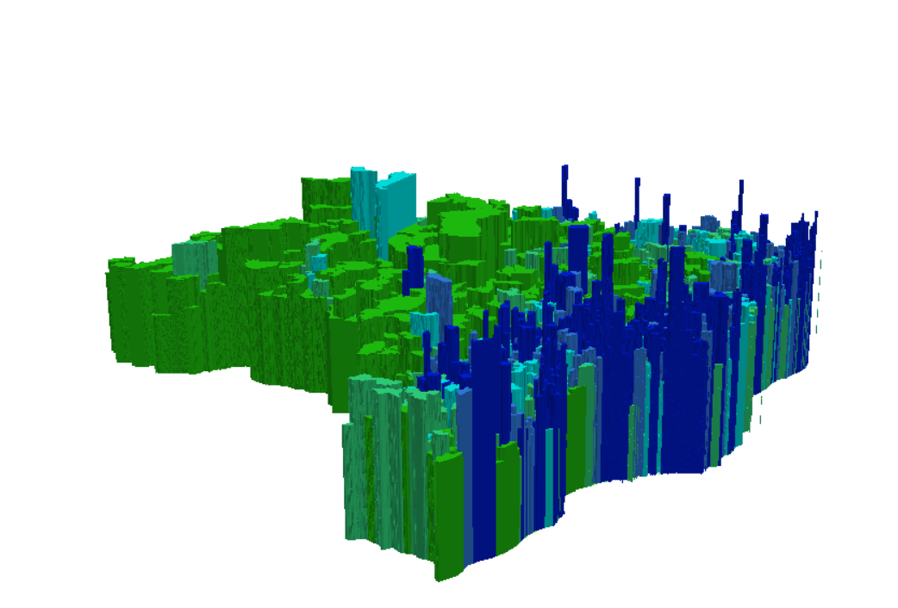
You can adjust the formula to dampen down the spikes. Sometimes, dividing by 10 or 100 or 1000 helps.
This image was extruded using log( [POP] ).

Slide 7
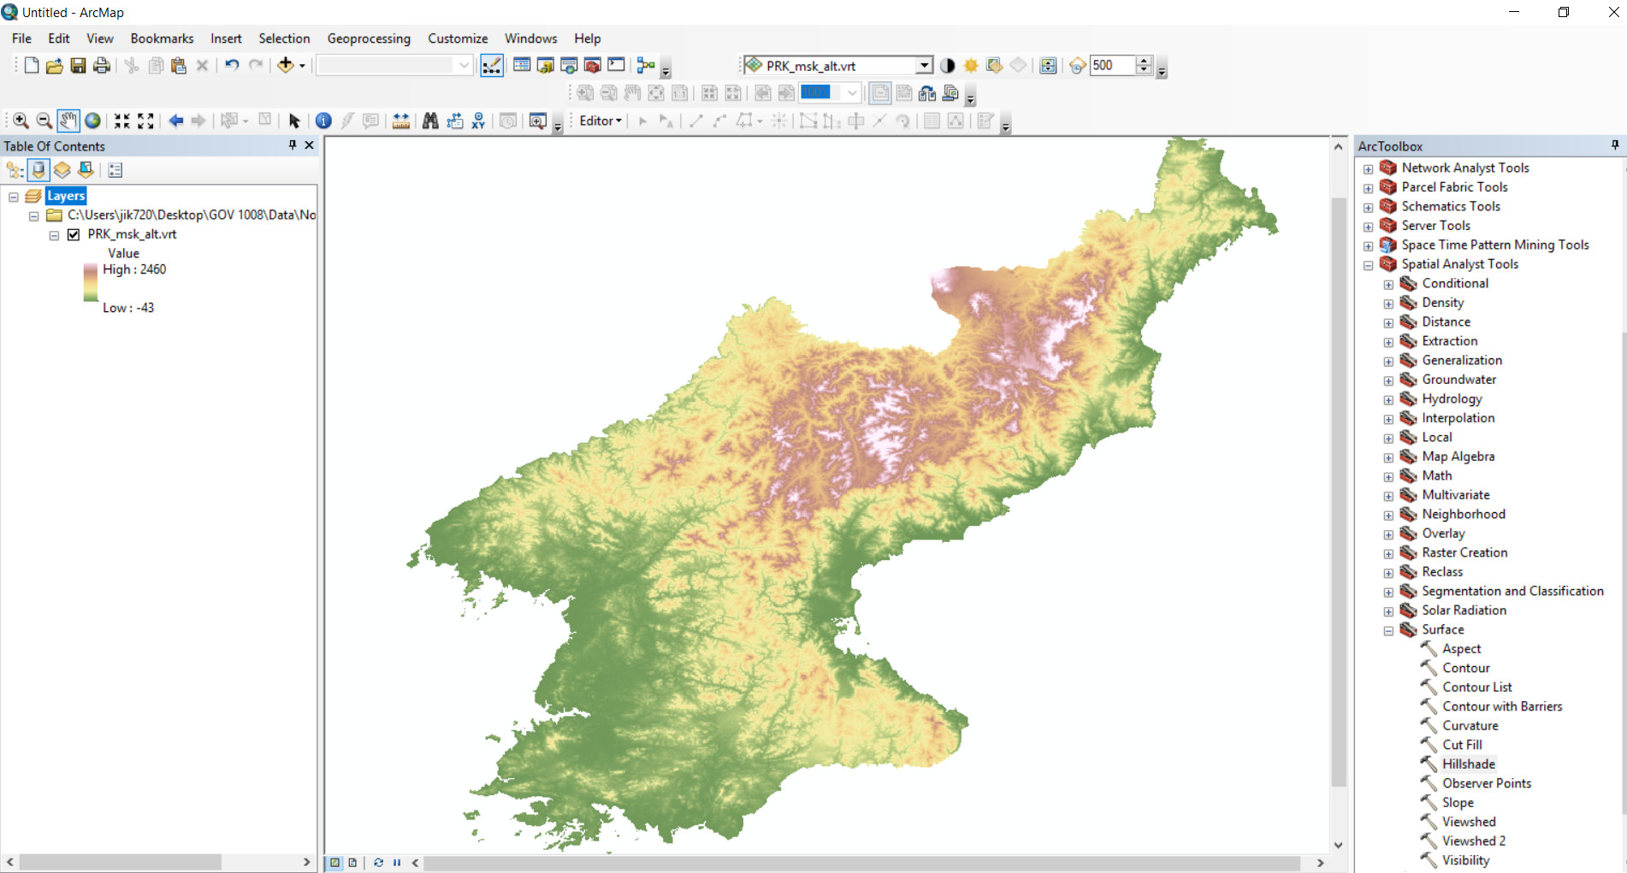
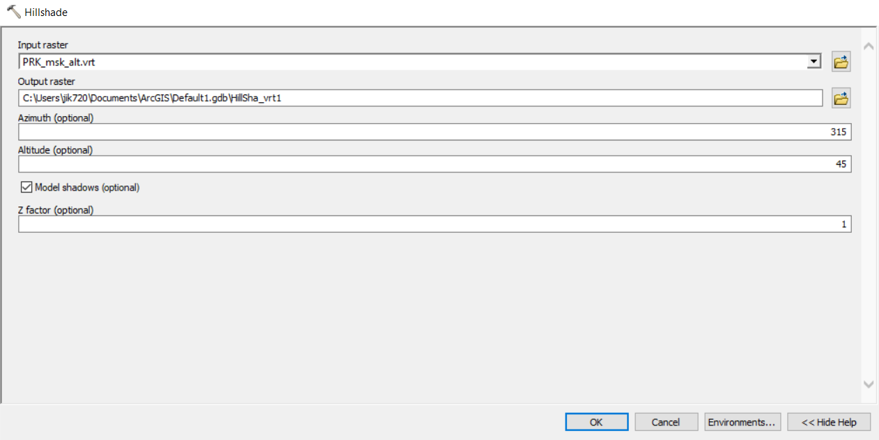
Displaying rasters in 3D
Hillshade is an ArcMap tool which models shadows. It can give a semi-3D look to a 2D elevation raster.
Run Hillshade on the North Korean elevation layer (PRK_msk_alt.vrt). Be sure to check the box that says “model shadows.”

Slide 8
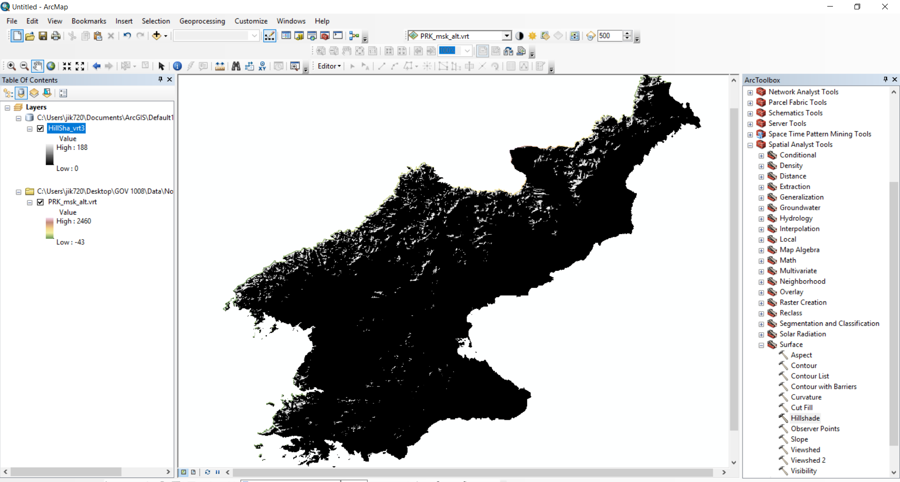
The result is not stunning. We could experiment with symbology, but the transparency tool on the “Effects” toolbar gives a nice visualization. Get the Toolbar under “Customize” and be sure to set the layer to the Hillshade layer.

Slide 9
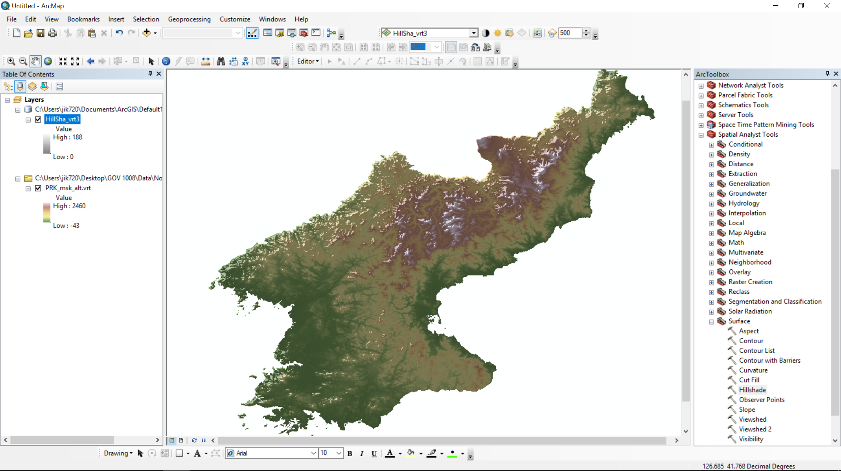
Turn the Hillshade layer on and off to see if you like the effect. Then please copy both raster layers and paste them in ArcScene.

Slide 10
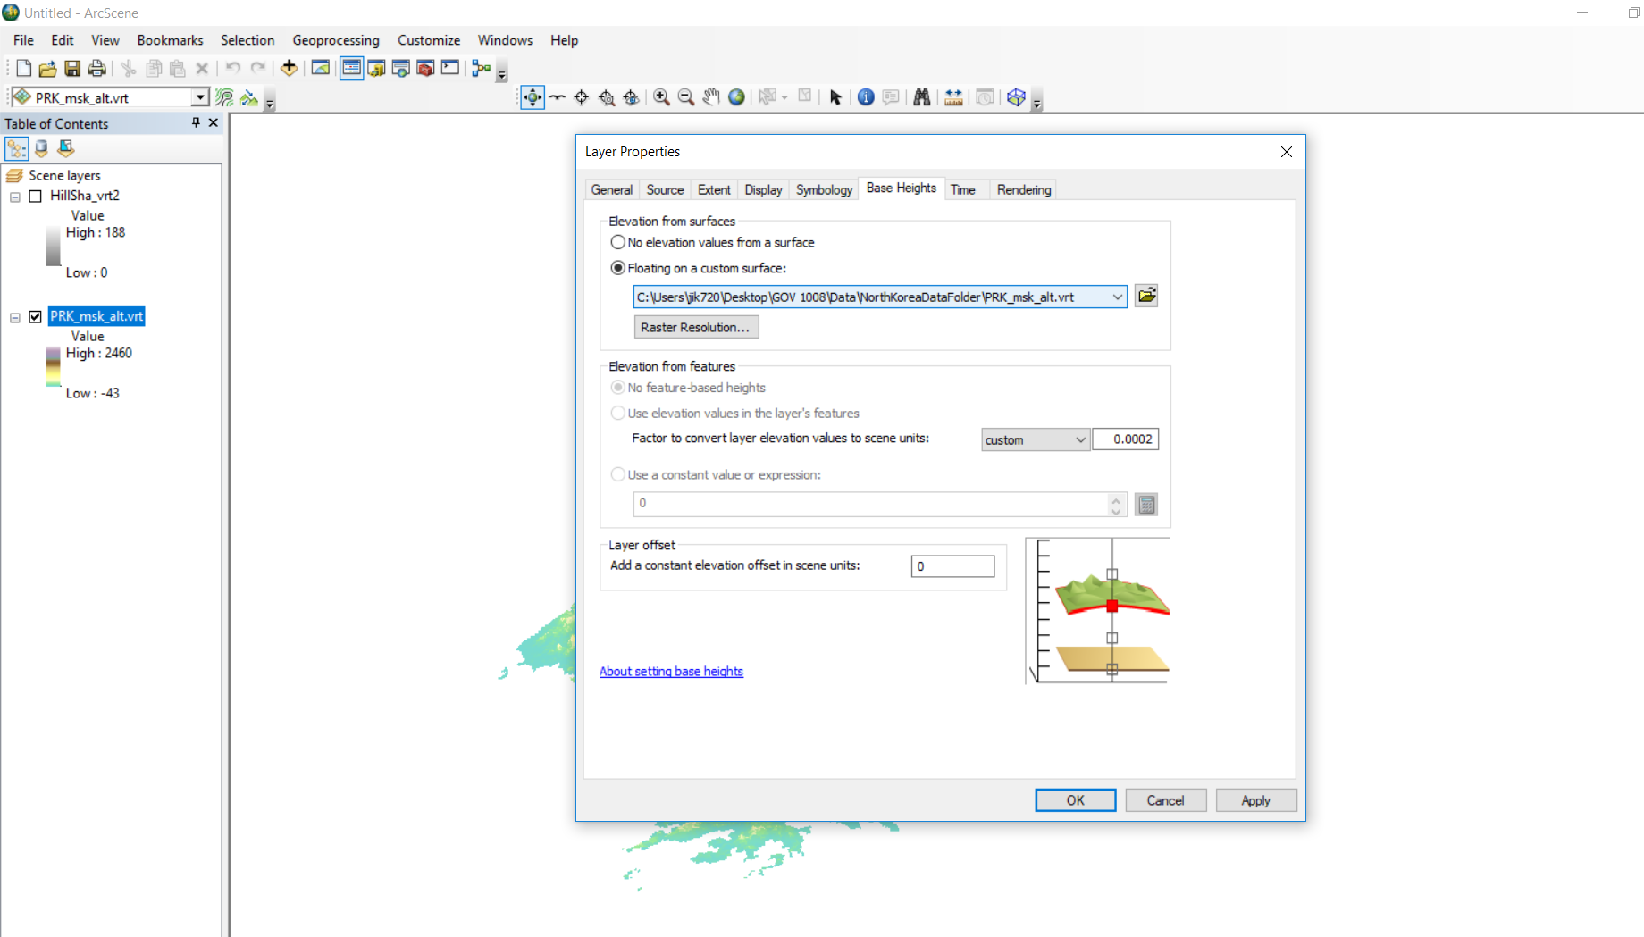
When you click on Properties on a raster in ArcScene, you will see a tab for “Base Heights.”
There are three settings to set here.
First, decide which raster will give the elevations of your 3D model. Use the elevations of North Korea.
Then, decide whether those elevations need a little exaggeration or suppression, adding a custom factor (0.0002).
We will use the offset setting in minute.

Slide 11
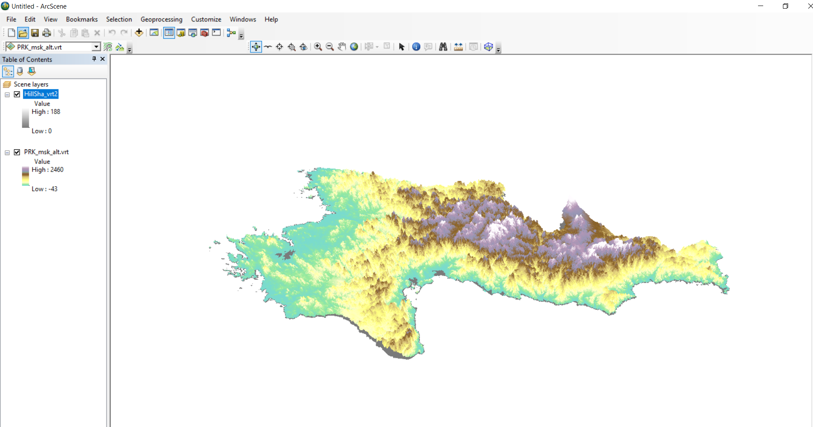

Slide 12
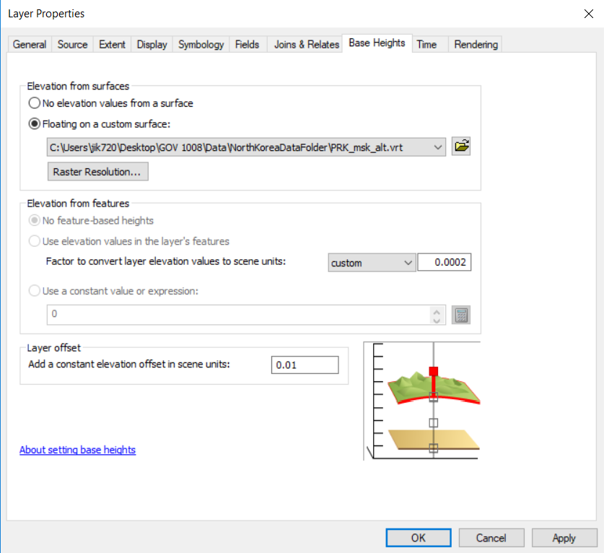
Now set the base heights for the Hillshade layer.
It will not float on its own values, but upon the values from the elevation raster.
The factor will be the same, but adding a very small offset will ensure that the semi-transparent hillshade is visible above the colored elevation raster.

Slide 13
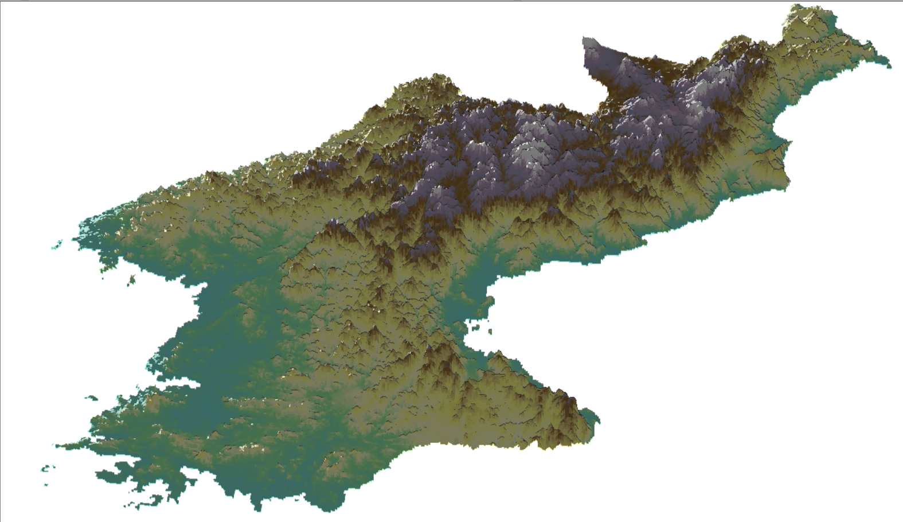

Slide 14
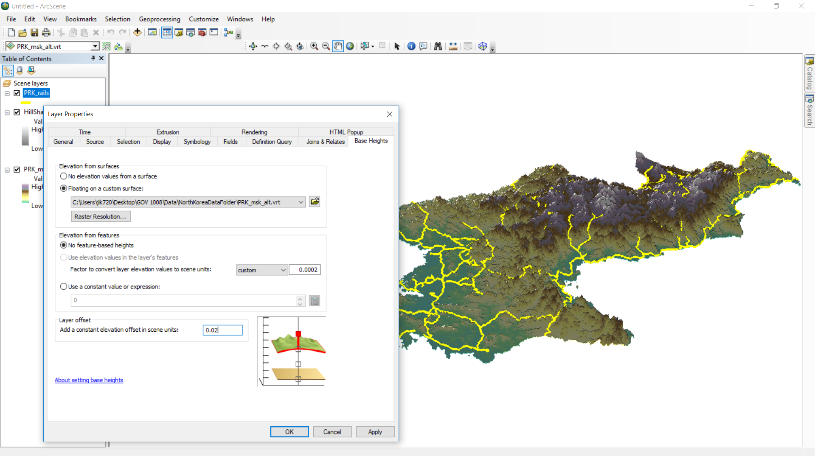
It is also possible to drape a vector layer on top of a raster layer. Add the PRK rail lines shapefile.
Properties > Base Heights will have the same options for this vector layer that were available for raster layers. A small offset keeps the vector layer from getting lost beneath the surface.

Slide 15
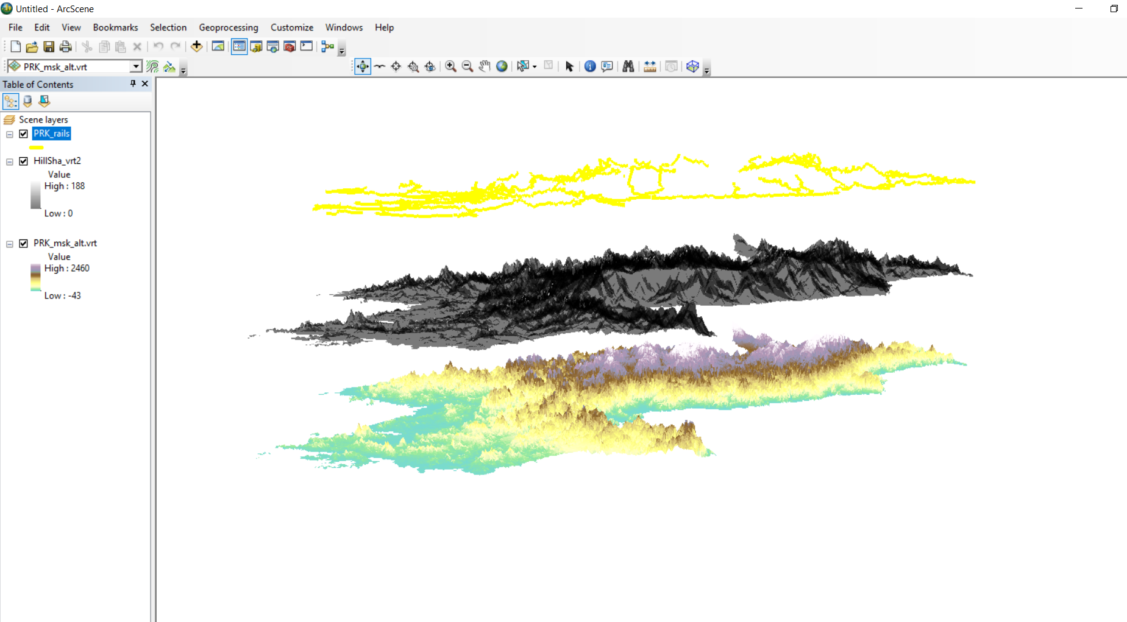
Larger offsets, here 0, 1, and 2, can also be used as a cartographic technique to separate layers in one display.

Slide 16
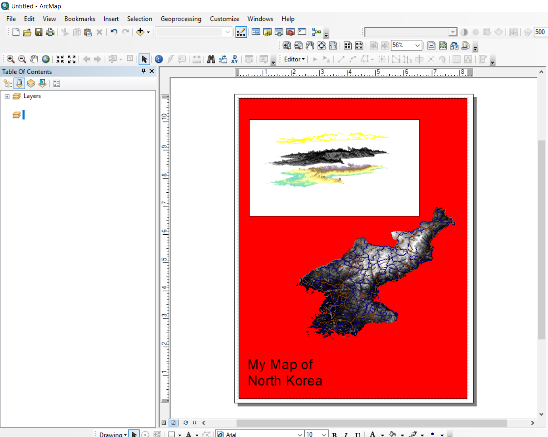
To get your 3D visualization back into ArcMap, you will export it as an image. From ArcScene, use
File > Export > 2D and save in an image format like .jpeg.
Then, in ArcMap layout view, use Insert > Picture and navigate to the saved image. It will appear as a fixed image, not a GIS layer.

Slide 17
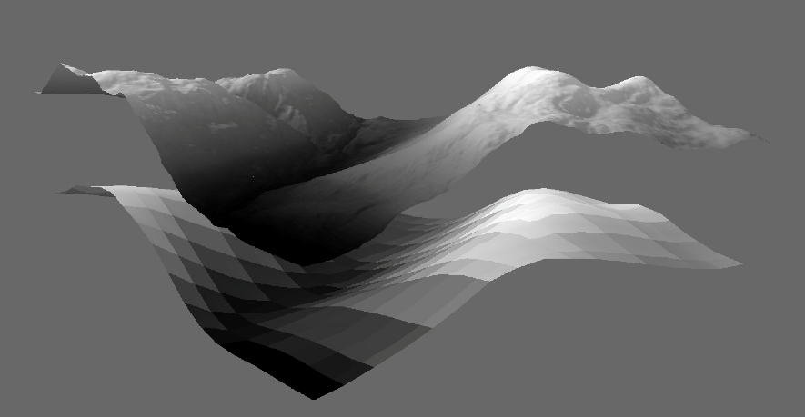
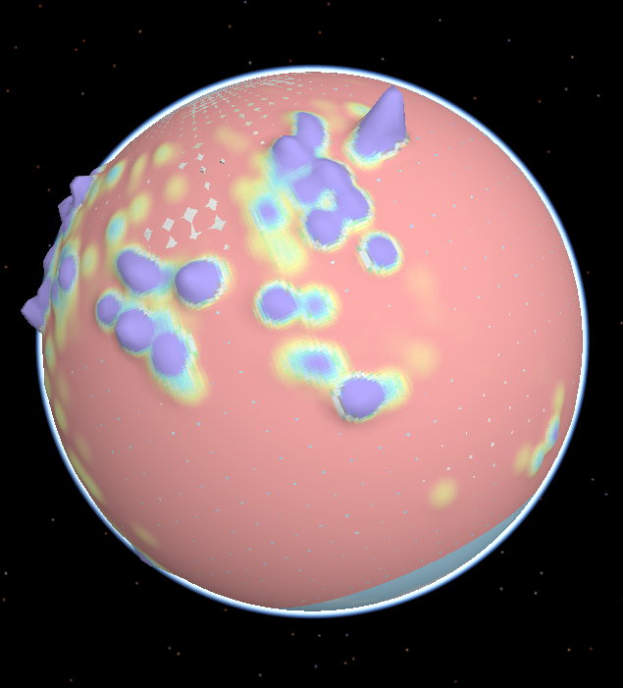
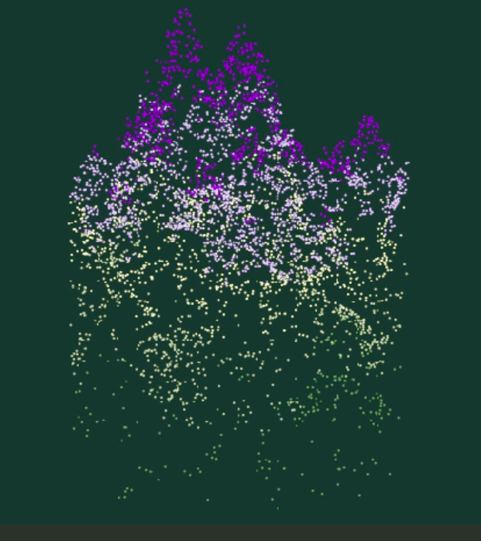
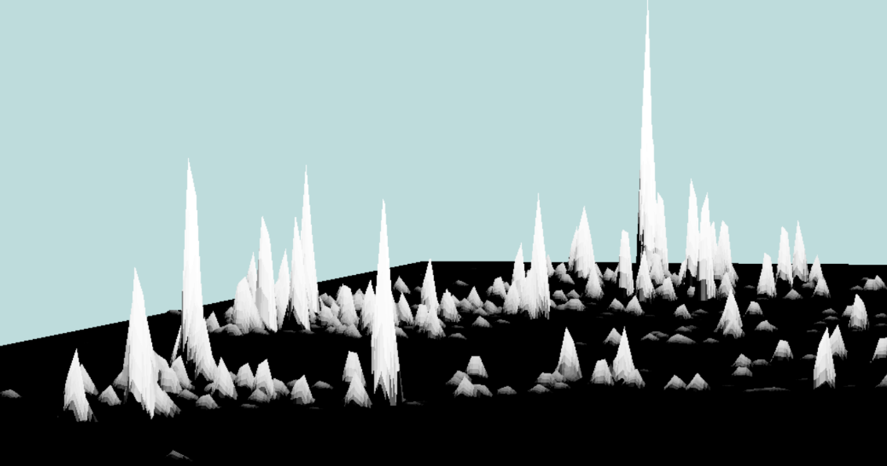
Postscript:
-- 3D visualization can sometimes sacrifice science for artistic license.
-- Surfaces don’t have to model real elevations; they can visualize other statistics.
-- 3D visualization is not 3D analysis. There is an entire 3D analysis package for ArcMap that includes the ability to create, analyze, and model TINs (triangulated irregular network).
-- ArcScene has a number of capabilities we haven’t explored, such as 3D labels.
-- ESRI CityEngine has impressive 3D visualization for cityscapes, so good it’s been used for movie scenery.

